Slide 1
Generative AI for Business Students (BCA)
Course: Generative AI
Module 1: AI Fundamentals
Instructor Name: Srajan Shukla
Institution Name: Institute of Technology & Science, Ghaziabad

Slide 2
Why Is Everyone Talking About AI?
AI tools are now:
  Easy to use
  Available to everyone
  Free or affordable
AI can now:
  Write emails & content
  Create images & designs
  Help in studies & jobs
ChatGPT made AI mainstream
AI is no longer future — it’s present

Slide 3
AI Myths vs Reality
Myth | Reality
AI will replace all jobs | AI will change jobs
AI thinks like humans | AI predicts patterns
AI is always correct | AI can make mistakes
AI is only for engineers | AI is for everyone

Slide 4
What is Artificial Intelligence?
Artificial Intelligence (AI) refers to the ability of a computer or machine to perform tasks that normally require human intelligence.
Examples of such tasks:
Learning
Problem solving
Decision making
AI = Computer with learning ability

Slide 5
Traditional AI – Rule-Based Systems
Traditional AI works on predefined rules
Uses IF–ELSE logic
Does not learn from experience
Output is predictable
Humans define all the rules
Examples:
Calculator
Traffic signal system
Rule-based chatbots
Simple games (Chess engines – early versions)

Slide 6
Machine Learning – Learning from Data
Machine Learning is a subset of AI
ML systems learn from data
They improve performance over time
No need to define every rule manually
Decisions are based on patterns
Examples:
Netflix / YouTube recommendations
Spam email detection
Face unlock in mobile phones
Credit card fraud detection

Slide 7
Generative AI – AI That Creates
Generative AI creates new content
It does not just analyze data
It can generate:
  Text
  Images
  Videos
  Code
Output looks human-like
Powered by large models trained on huge data
Examples:
ChatGPT – text & ideas
DALL·E – image generation
Midjourney – creative designs
AI music & video tools

Slide 8
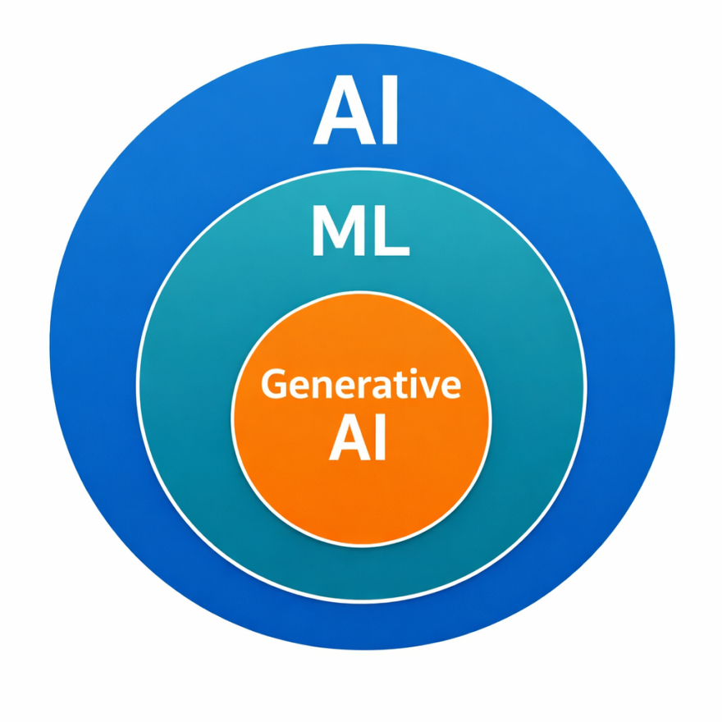
AI vs Machine Learning vs Generative AI
Artificial Intelligence (AI) is the umbrella term
Machine Learning (ML) is a subset of AI
Generative AI is a subset of ML
Each level adds more intelligence and capability
Generative AI is the most advanced form today

Slide 9
Comparison Table – AI vs ML vs Generative AI
Feature | Traditional AI | Machine Learning | Generative AI
Decision style | Rule-based | Data-based | Pattern + creation
Learning ability | ❌ No | ✅ Yes | ✅ Yes
Content creation | ❌ No | ❌ No | ✅ Yes
Output | Fixed | Predictive | Creative
Examples | Calculator | Netflix | ChatGPT

Slide 10
Real-Life Examples You Use Every Day
Traditional AI:
  Calculator
  Traffic lights
Machine Learning:
  Netflix / YouTube recommendations
  Google Maps routes
Generative AI:
  ChatGPT writing answers
  AI image generators
  Resume & content tools

Slide 11
Identify AI, ML, or Generative AI
A calculator adds two numbers
Netflix recommends a movie
ChatGPT writes an email
Phone unlocks using face
AI creates a logo

Slide 12
How Do Machines Understand Human Language?
Humans communicate using natural language
Computers understand only numbers
To bridge this gap, AI uses:
Language processing techniques
AI does not “understand” like humans
It finds patterns in language
AI understands language by converting words into numbers.

Slide 13
Natural Language Processing (NLP)
NLP is a branch of AI
It helps machines:
  Read text
  Understand meaning
  Respond in human language
NLP is used in:
  Chatbots
  Voice assistants
  Translation tools
NLP works on text and speech
Examples:
Google Translate
Voice assistants
Chatbots like ChatGPT
NLP is the bridge between humans and machines.

Slide 14
Text to Numbers – The Language of AI
Computers do not understand words or sentences
AI works only with numbers
Every word is converted into a numerical representation
These numbers capture:
  Meaning
  Relationships
  Similarity between words
This conversion enables AI to learn language
For AI, numbers are meaning.

Slide 15
Tokens – Breaking Text into Processable Units
AI does not read full sentences at once
Text is split into tokens
Tokens can be:
  Full words
  Parts of words
  Characters
Tokens are the basic input for AI models
Fewer tokens = faster processing
Example
“Generative AI is powerful”
→ Generative | AI | is | power | ful

Slide 16
Context – Giving Meaning to Tokens
Words alone do not give meaning
Meaning depends on context
AI looks at surrounding tokens
Context helps AI:
  Understand intent
  Predict correct responses
  Avoid ambiguity
Example
Bank → Money context
Bank → River context

Slide 17
Large Language Models (LLMs)
LLMs are powerful language models
Trained on massive text data
Learn:
  Grammar
  Semantics
  Language patterns
Can generate:
  Text
  Answers
  Summaries
Power behind modern GenAI tools
Examples
ChatGPT | Gemini | Claude

Slide 18
How Generative AI Generates Responses
User inputs a prompt
Text is converted into numbers
Model analyzes context & patterns
Predicts the next most likely word
Repeats until response is complete
Final Insight
Generative AI predicts language — it does not think.

Slide 19
Generative AI Tools – The Ecosystem
Generative AI tools help humans:
  Create content
  Generate ideas
  Solve problems faster
Different tools are built for different purposes:
  Text
  Images
  Research
  Creativity
These tools are powered by Large Language Models
Tools change, but the core GenAI concept remains the same.

Slide 20
ChatGPT – The Most Popular GenAI Tool
ChatGPT is a conversational AI tool
It can:
  Answer questions
  Write emails & content
  Help in learning & coding
  Brainstorm ideas
Easy to use: just type in natural language
Used by students, professionals, and companies
Key Insight
ChatGPT made AI accessible to everyone.

Slide 21
Gemini & Claude – Advanced AI Assistants
Gemini (Google):
  Strong in multimodal tasks
  Works with text, images, and data
Claude (Anthropic):
  Designed for long documents
  Focus on safety & clarity
Both are alternatives to ChatGPT
Choice depends on use case
Key Message
Different tools for different needs.

Slide 22
DALL·E & Midjourney – AI That Creates Images
These tools convert text prompts into images
Used in:
  Marketing
  Design
  Advertising
  Social media
Anyone can create professional visuals
No design skills required
Examples
DALL·E | Midjourney
Key Insight
Words become visuals using Generative AI.

Slide 23
Prompting – How to Talk to AI
A prompt is the instruction given to AI
Better prompts produce better outputs
Good prompts include:
  Clear instructions
  Context
  Desired format
Prompting is a core GenAI skill
Final Takeaway
AI quality depends on prompt quality.

Slide 24
Prompt Engineering – Asking the Right Way
Prompt engineering means:
  Writing clear and structured instructions
Good prompts include:
  Role (Who is AI?)
  Task (What to do?)
  Context (Background)
  Format (Output style)
Better prompts = better answers
Key Message
You don’t control AI — you guide it.

Slide 25
Prompt Engineering Task
promotional email for college students about a new online business course.
Instagram caption for a new café opening in the city
You are working in the HR department of a company.
You need to inform a job candidate about their interview schedule.
You work in a customer support team of an e-commerce company.
A customer is unhappy due to late delivery and has sent a complaint email.

Slide 26
Evolution of Artificial Intelligence
AI has evolved step-by-step
Major phases:
  Rule-based systems
  Machine Learning
  Deep Learning
  Generative AI
Each phase made AI smarter and more useful
Key Insight
Generative AI is the result of decades of evolution.

Slide 27
AI Journey – How We Reached Generative AI
Early AI followed strict rules
Machine Learning learned from data
Deep Learning handled complex patterns
Transformers enabled context understanding
Generative AI can now create content
Final Takeaway
AI evolved from following rules to creating ideas.

Slide 28
Generative AI Across Industries
Generative AI is transforming multiple industries
Used to:
  Automate tasks
  Improve decision-making
  Increase productivity
Businesses use GenAI to:
  Save time
  Reduce costs
  Improve customer experience
Adoption is increasing rapidly
Key Message
Generative AI is a business enabler, not just a tech trend.

Slide 29
Generative AI in Healthcare
Assists doctors in:
  Medical report generation
  Clinical documentation
Helps analyze patient data faster
Supports diagnosis & treatment planning
Reduces administrative workload
Real-World Examples
  AI-generated medical summaries
  Virtual health assistants

Slide 30
Generative AI in Finance
Automates:
  Financial reports
  Risk analysis
Improves fraud detection
Enhances customer support using chatbots
Assists in investment research
Real-World Examples
AI-powered banking chatbots
Automated compliance reports

Slide 31
Generative AI in Education & Marketing
Education:
  Personalized learning content
  AI tutors & doubt solving
  Automated assignment feedback
Marketing:
  Content creation (ads, blogs, emails)
  Social media posts
  Campaign idea generation
Key Insight
Generative AI amplifies human creativity.

Slide 32
The ChatGPT Phenomenon
ChatGPT launched in 2022
Became the fastest-growing consumer app
Reached millions of users in weeks
Used by:
  Students
  Professionals
  Businesses
Changed how people interact with AI
Key Insight
ChatGPT brought AI to the masses.

Slide 33
Why ChatGPT Became So Popular
Simple chat-based interface
No technical knowledge required
Works in natural language
Provides instant responses
Free or low-cost access
Key Message
Ease of use drives adoption.

Slide 34
Opportunities & Risks of Generative AI
Opportunities
  Higher productivity
  Faster learning
  Creativity at scale
Risks
  Incorrect information
  Over-dependence on AI
  Ethical & privacy concerns
Key Insight
Responsible use is critical.

Slide 35
Future Skills in the Age of Generative AI
Prompt writing
Critical thinking
AI-assisted decision making
Domain knowledge + AI tools
Ethical AI awareness
Final Takeaway
AI won’t replace you — someone using AI will.

